Slide 1


Welcome
To
Our Project Presentation

Slide 2

Team members
01.
Md Ashraful islam
Roll: 22102004
Reg: 10810
02.
Md Tanim ishrak
Roll: 22102032
Reg: 10838
Supervised by
Dr. md. Selim al mamun
Professor
Department of CSE, JKKNIU

Slide 3
Project Title
typing tutorial

Slide 4


Table of content
Project Introduction
01
04
Methodology
Here we will describe what is the project will serve
Here we will describe the development stage.
Game Flow
02
05
Limitations
We will describe the flow of the project
Here we will describe the limitations of the project.
Game Interface
03
06
Future scope
We will see some interface of the project.
Here are some future scope of the project.

Slide 5
Project Introduction
“Typing Tutorial” is a typing game
Player types letters from keyboard
Player has to input correct spelling of coming word
The size of the word can be increases by selecting word length
The score is based on the word length. Like player input “eat” score will be 3 ,input “love” score will be 4

Slide 6
Game Flow
The game “Typing Tutorial” starts, generates new words and makes a slide movement from right to
left.
Then the main part of the game starts, where the player must write the correct word to get points and save lives.
The score of the game depends on the length of the word in the game.
If the player failed to write the word within the screen present, then the word will vanish, and life will be reduced. If life is zero, then the game ends.

Slide 7
Game Flow
Start
Select Word
Length
Word
Generate
Score
Time over
Correct
Life decrease
Zero Life
Exit

Slide 8
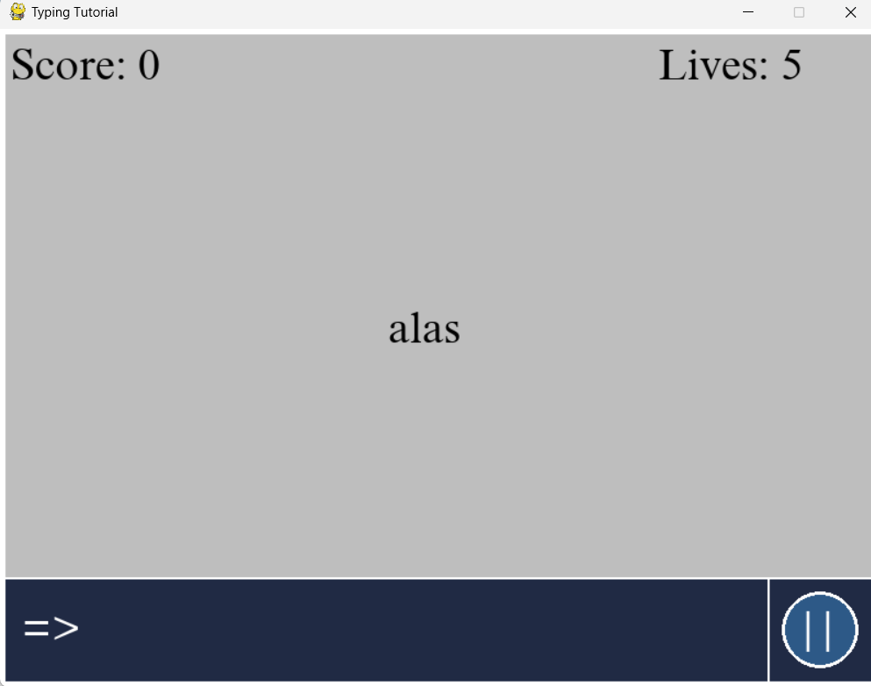
Game Interface
Game play: The game “Typing Tutorial” starts like this. In here word coming from right side and player inputs “=>” here.

Slide 9
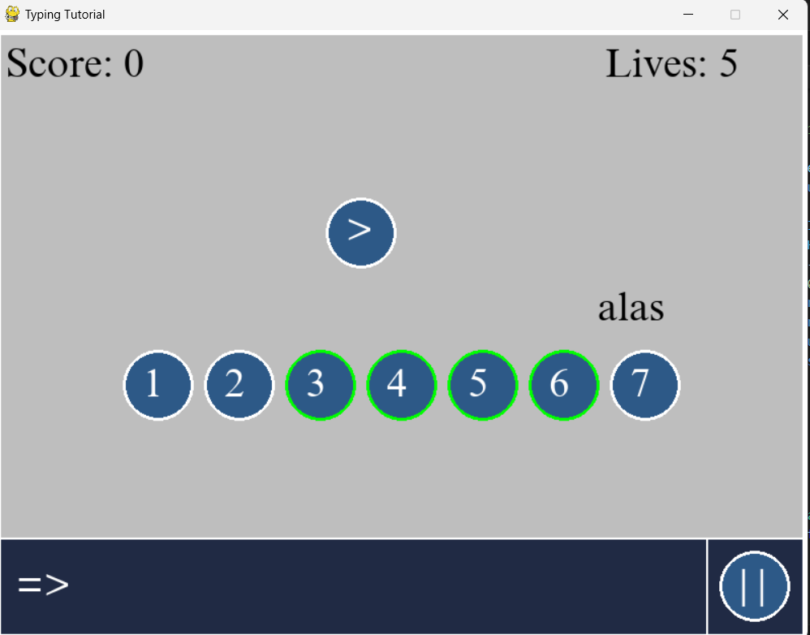
Game Interface
Gameplay: Player can select the length of a word. The length can be multiple or constant. Default length is 2. Length can be select from 1 to 7.

Slide 10
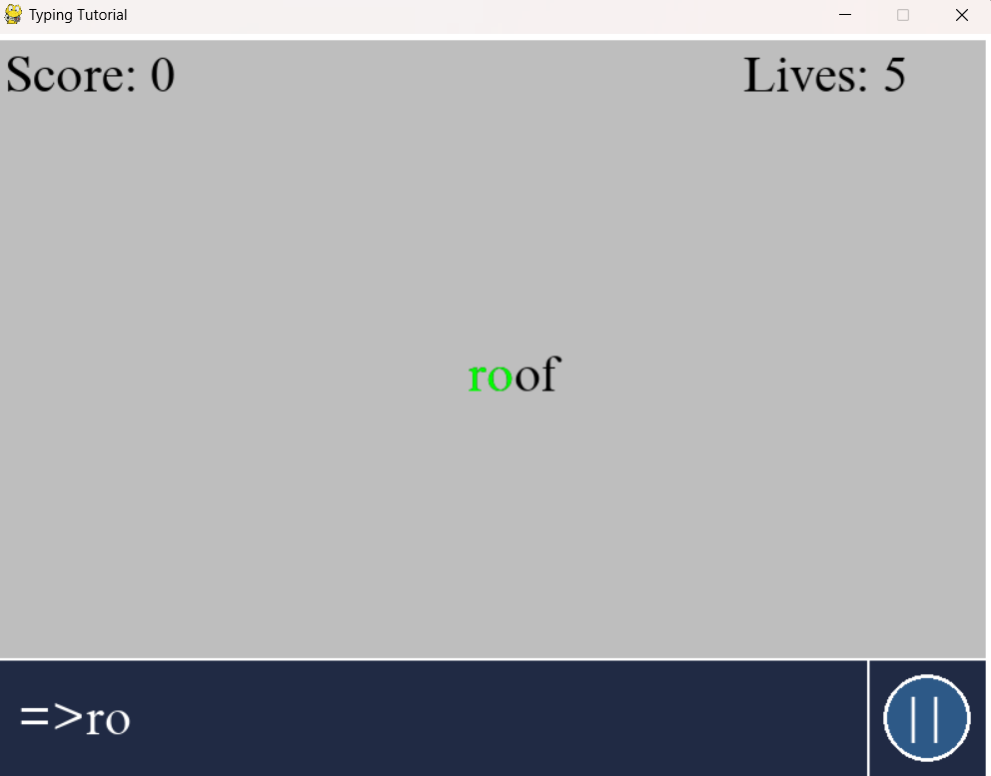
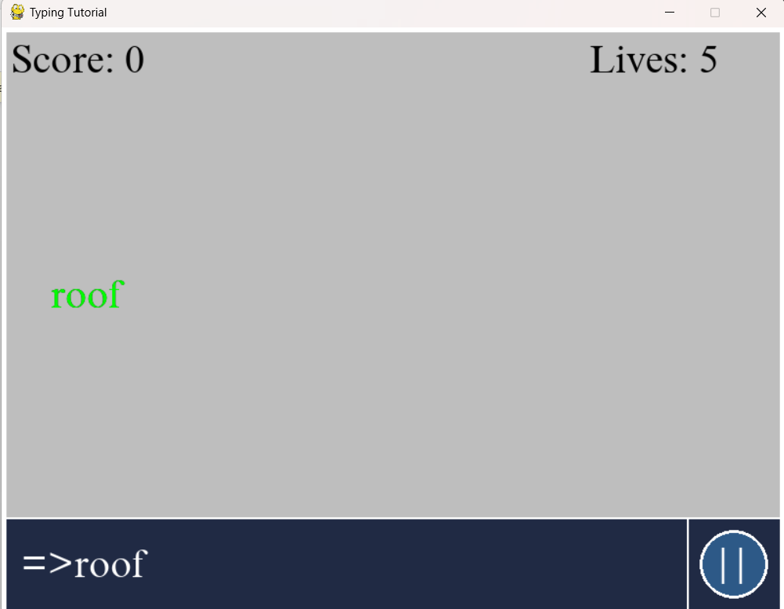
Game Interface
Game Play: If player input letter of a word correctly the coming word become green else word remain black.

Slide 11
Game Interface
Backgrounds: There is word “roof” and player input the right spelling. Thus, the word turn into green. After enter the word “roof” the score will change like that 0+4(length of the word) =4.
The Desert

Slide 12
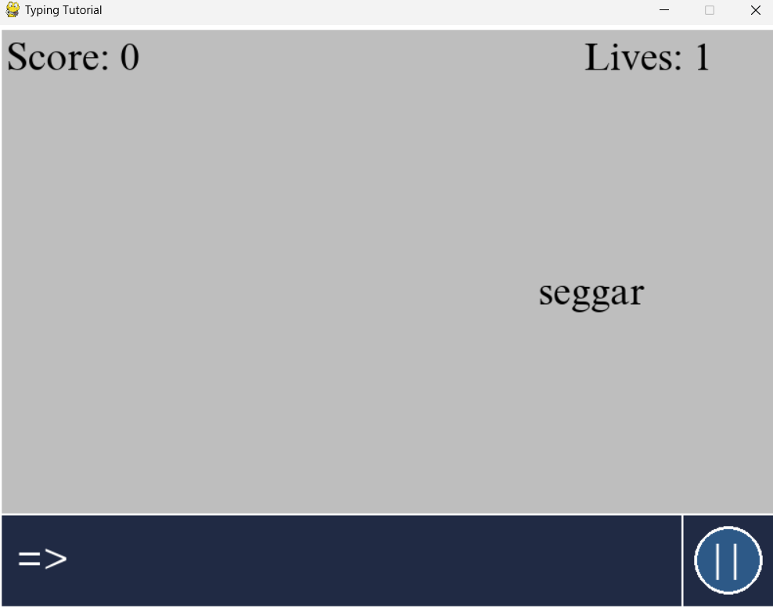
Game Interface
Backgrounds: There are default 5 lives in this game. If player misses 5 word to input the game will end here.

Slide 13

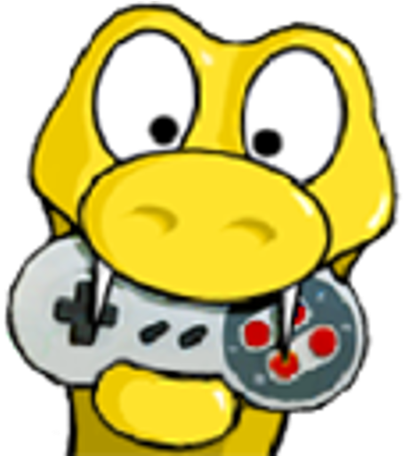

Methodology
The game was made with Python Programming Language
The modules “Pygame” was used
Pycharm was used as the code editor

Slide 14
Limitations
This game does not have a score recording system
It can’t show top score
It has no sound system
It has fixed background
It can’t be played on a mobile phone

Slide 15
Future scope
We can add levels to make word coming fast
We can add custom background selection
We can add previous best score of a player
We can add sound system
We can add all time top scored player

Slide 16
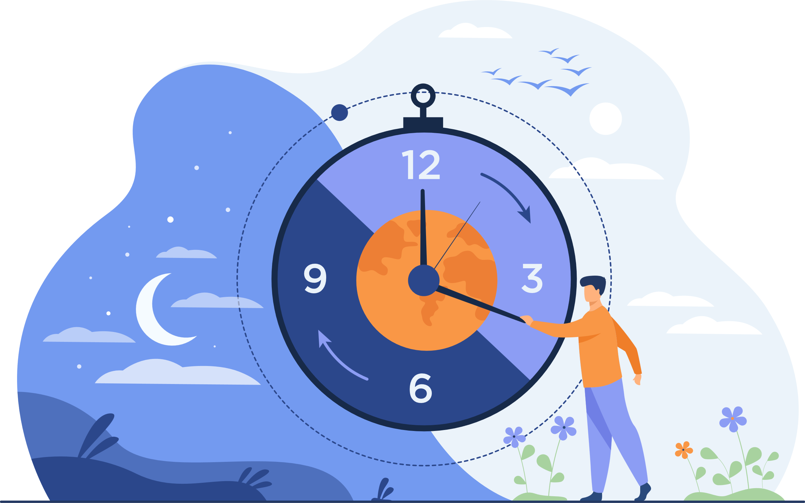
Thank you
for your patience

Slide 17

Any Questions?

